Slide 1

Notes:
Hi everyone, welcome to the very first Innovation Workshop for the Commercial Division. To many of you I am the only new face here. A little bit introduction about myself, I spent the past 10 years building innovative product and business solutions for all kinds of companies from fortune 500 to statups, from consumer internet to 2B or SaaS.
from my first job at Deloitte Consulting, I helped w multiple fortune 500 traditional companies building their innovation programs and start their digital transformation, companies including Valero, BlueCross Blue Shield, Boeing, Veteran Affairs etc. Then I was lucky enough to start my own company in consumer internet in social network space and was able to go thru the full product development lifecycle and team building until series A.
Before Matson I led an innovation program at Advanced Data and Analytics at Federal Reserve Bank SF building big data solutions for the board to support FOMC. I do not come from a shipping/ logistics background but I hope to provide my knowledge from a different lens and experience at running innovation programs at other companies to Matson and standup our own function dedicated to running fast experiments and pilot programs that ultimately blossom into full fledged business solutions/ tech products.

Slide 2
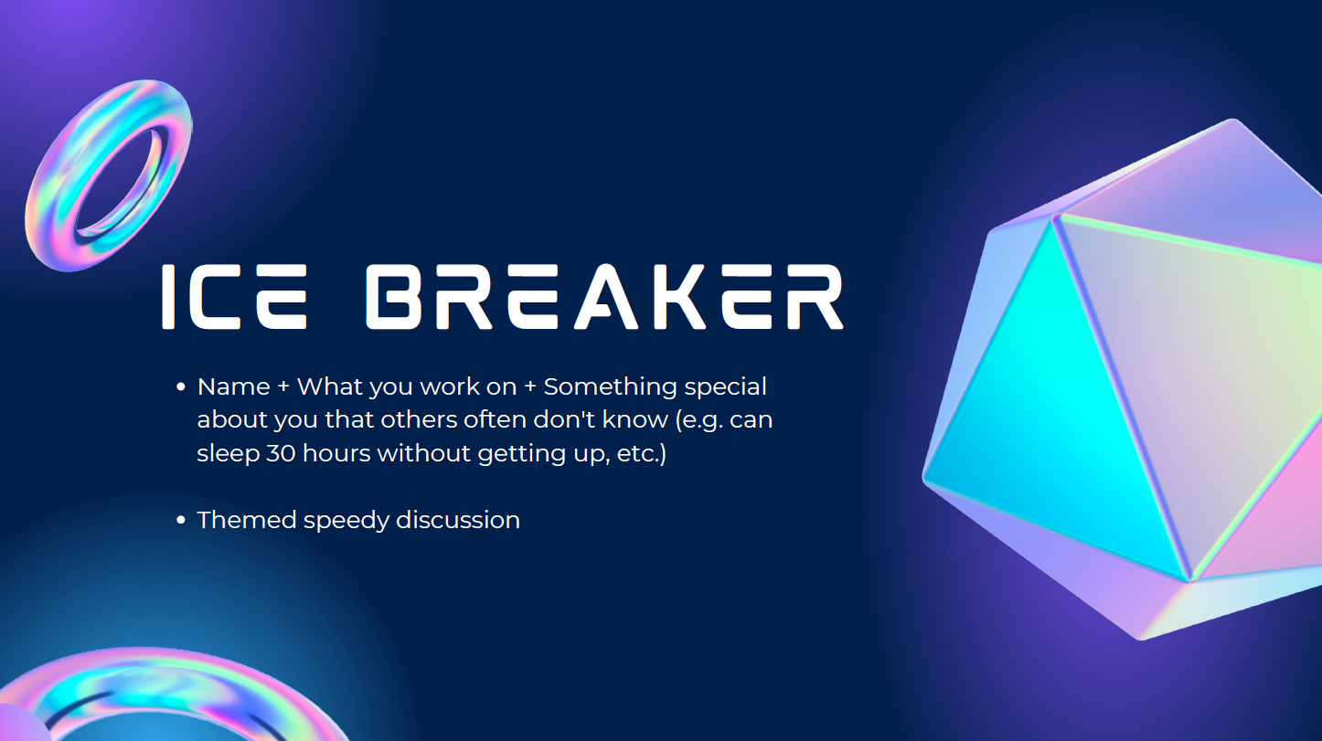
Notes:
First, 15 second speedy introduction of yourself
Second, I will give you a key word to discuss about, please huddle w your desk mate on the left, after 2 mins I will pick a pair to share.
10 mins total for ince breaker

Slide 3


Slide 4


Slide 5
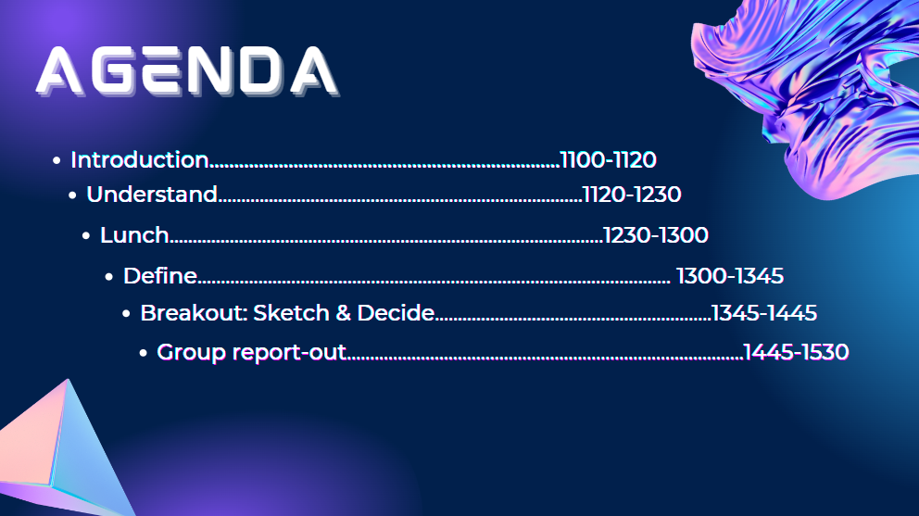

Slide 6
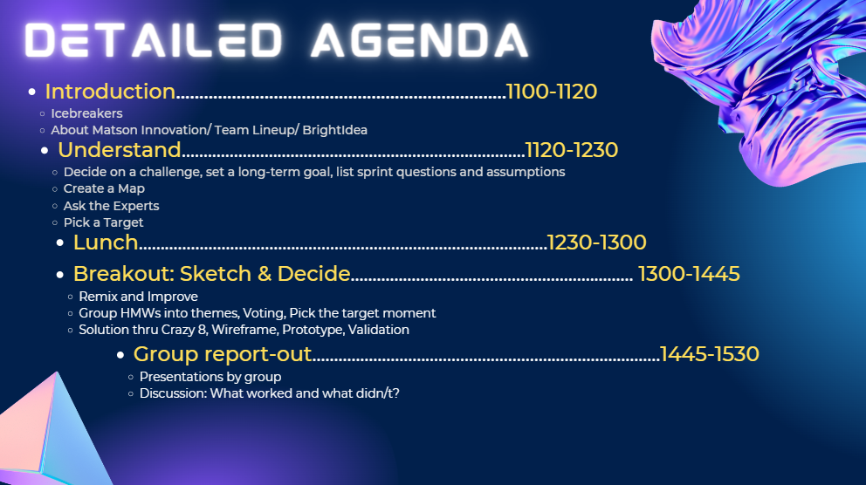

Slide 7
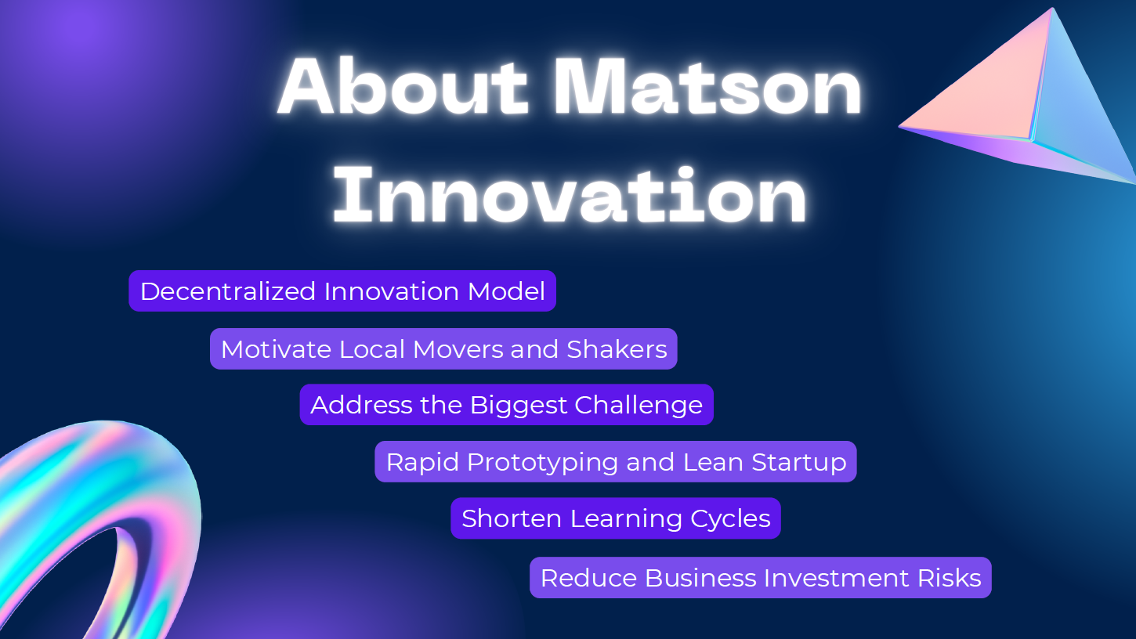
Notes:
5 mins. We are open to hear what you want us to be, how you think we should add value to you or Matson. Open for Q & A.

Slide 8
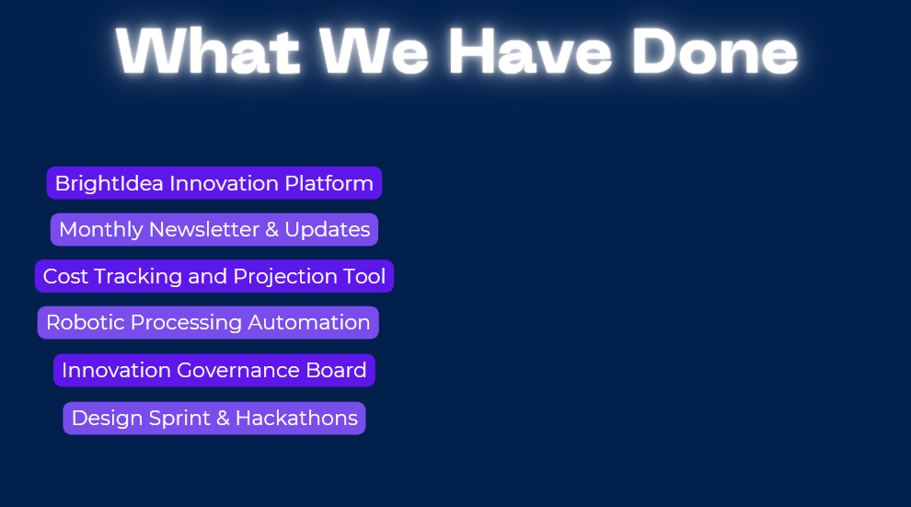
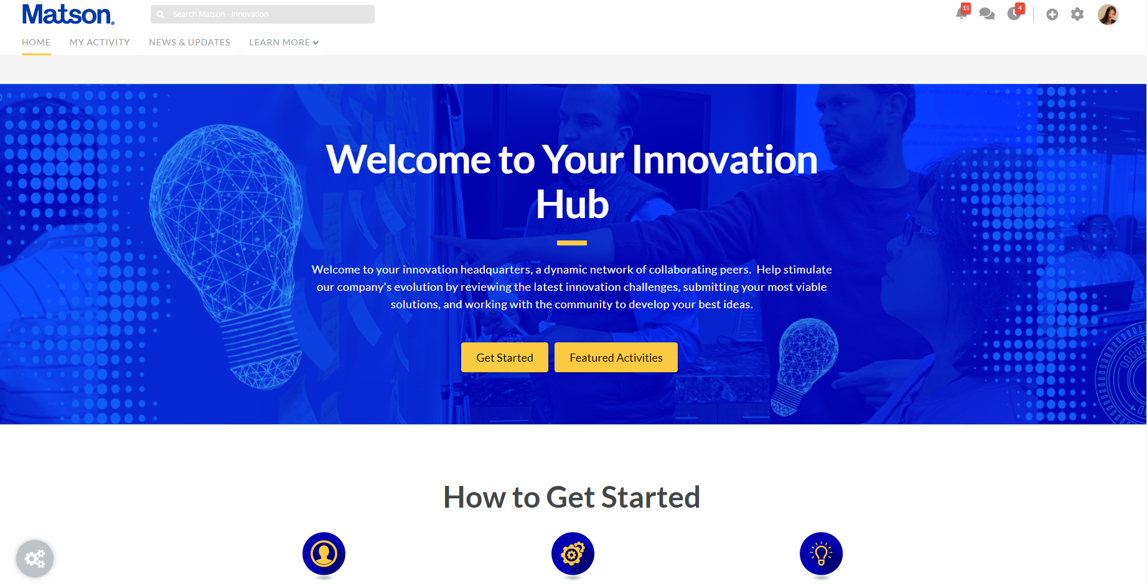
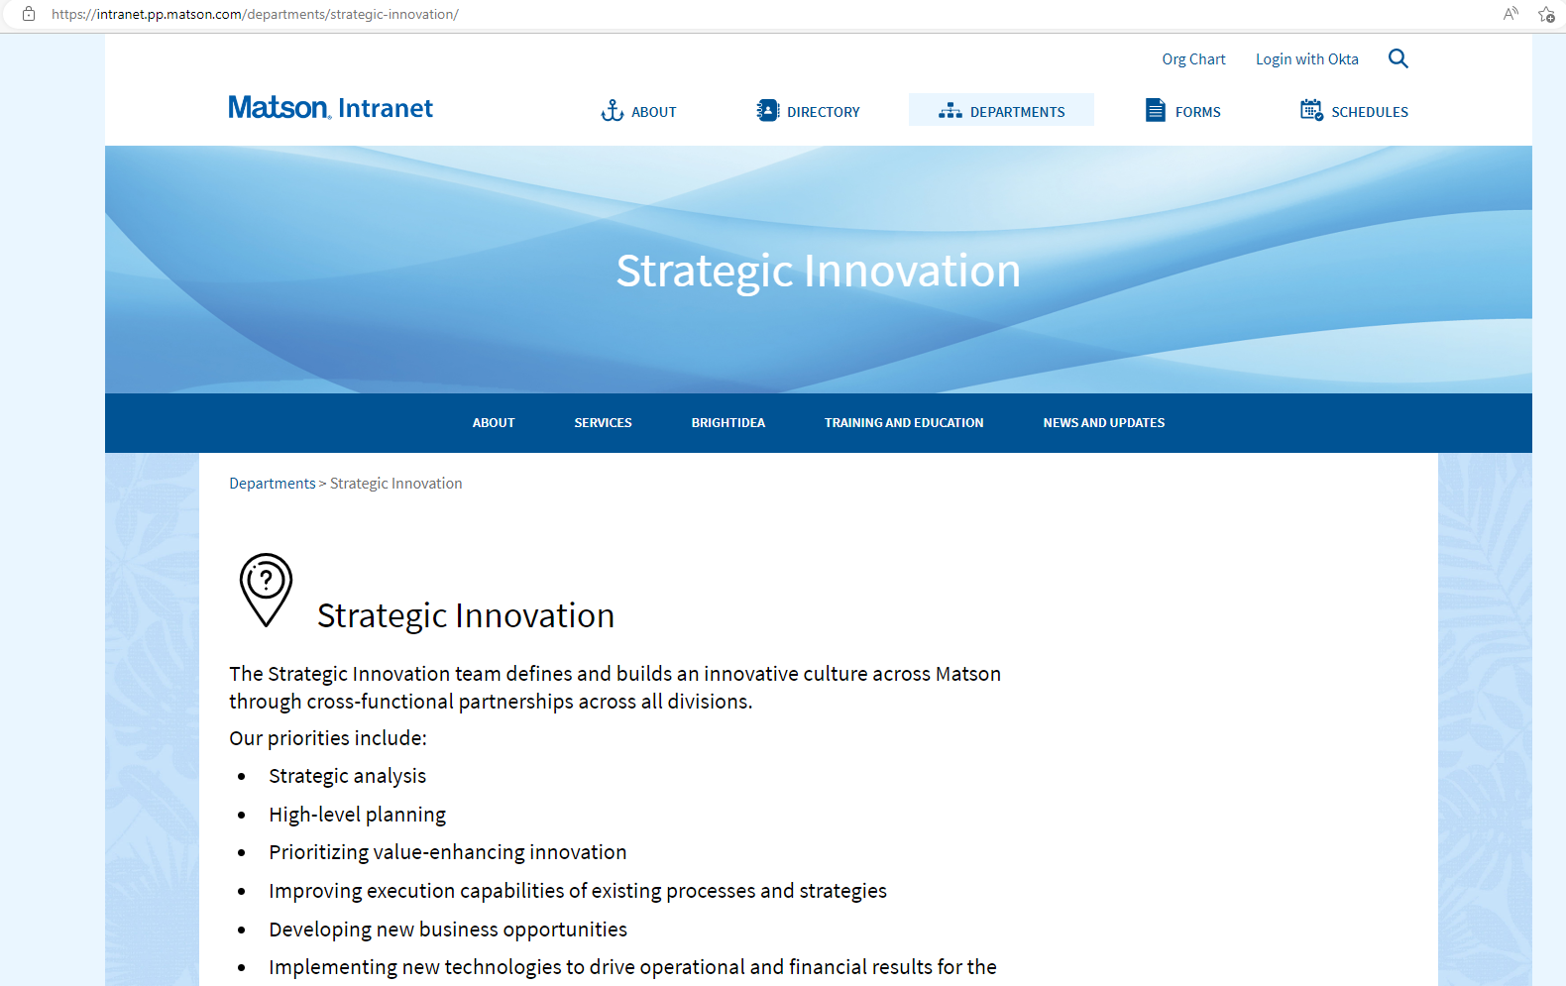
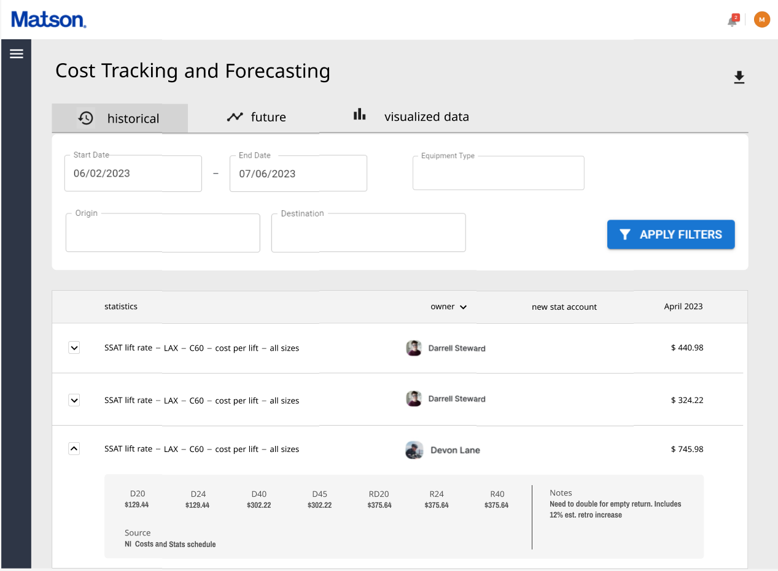
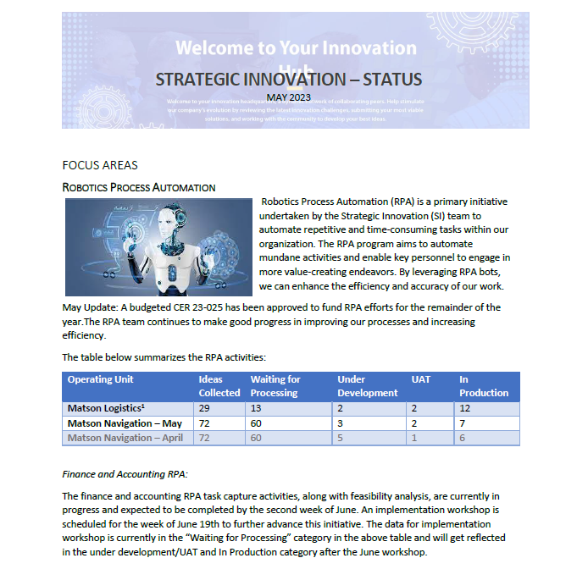
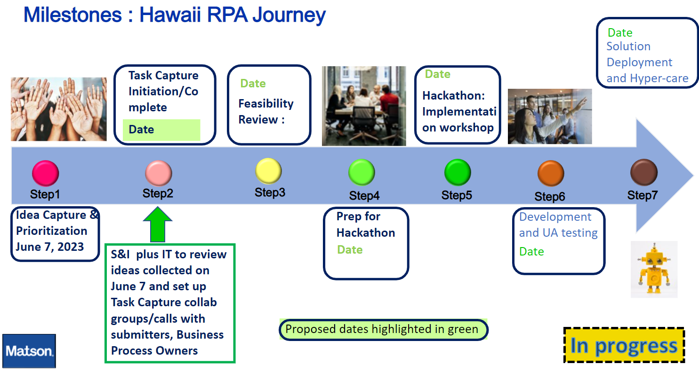


Slide 9
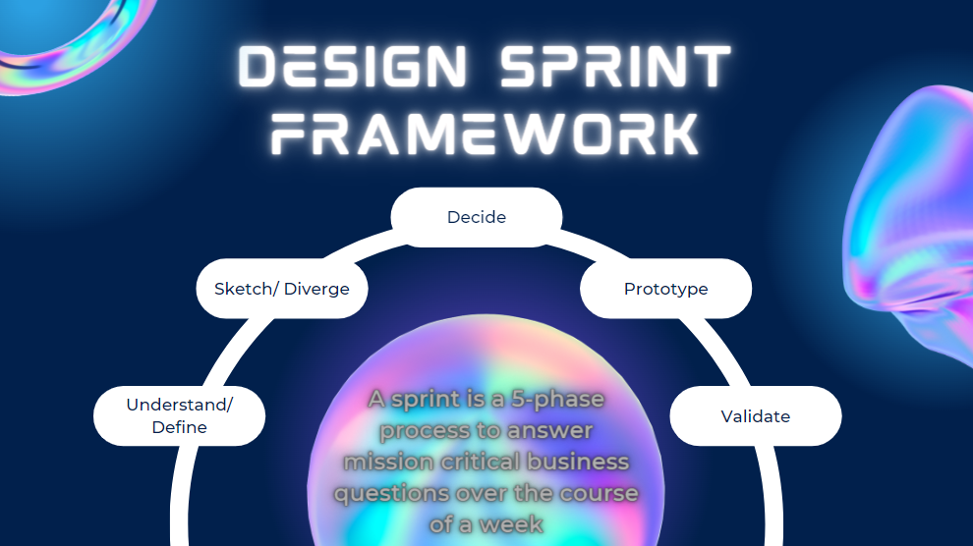
Notes:
What have you learned about Design Sprint – the framework we are following today?
5 years ago, I learned this methodology from my Mentor Elliott Ng who was then a senior director at Google Search and Ads. Under his mentorship I was able to assist him to run dozens of design sprint workshops at Product School in San Francisco for people from very diverse backgrouds. Some of the sprints we ran have given birth to a couple prominent products such as Clubhouse.
Now at Area 120, Elliott and other Google Venture partners have used this method to help their incubated startups test new ideas in the most time efficient and economical manner. This is why we we sitting together today to go thru this process to help a 140 year old company to identify the most pressing business challenges, and navigate through uncertainties and the tradeoffs between time, speed and money through rapid prototyping.

Slide 10
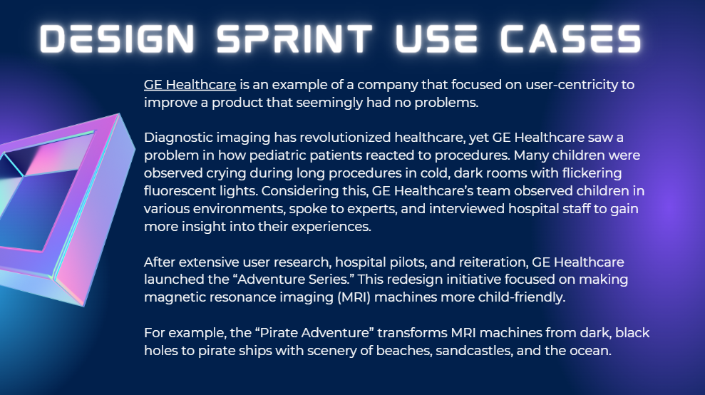

Slide 11
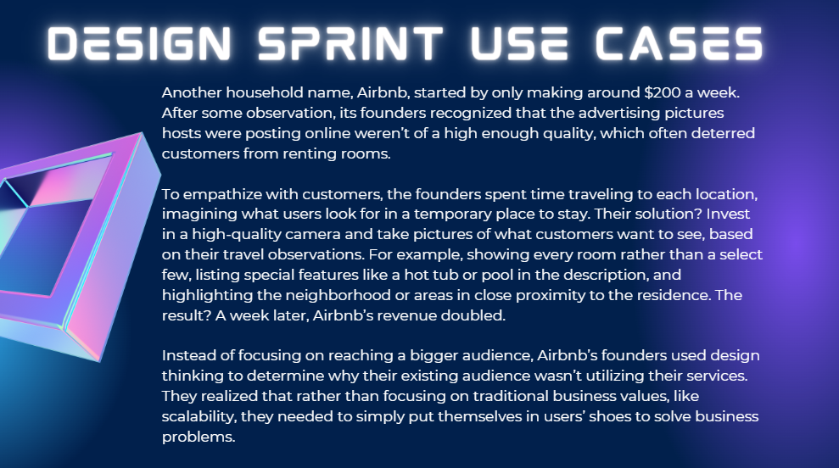

Slide 12
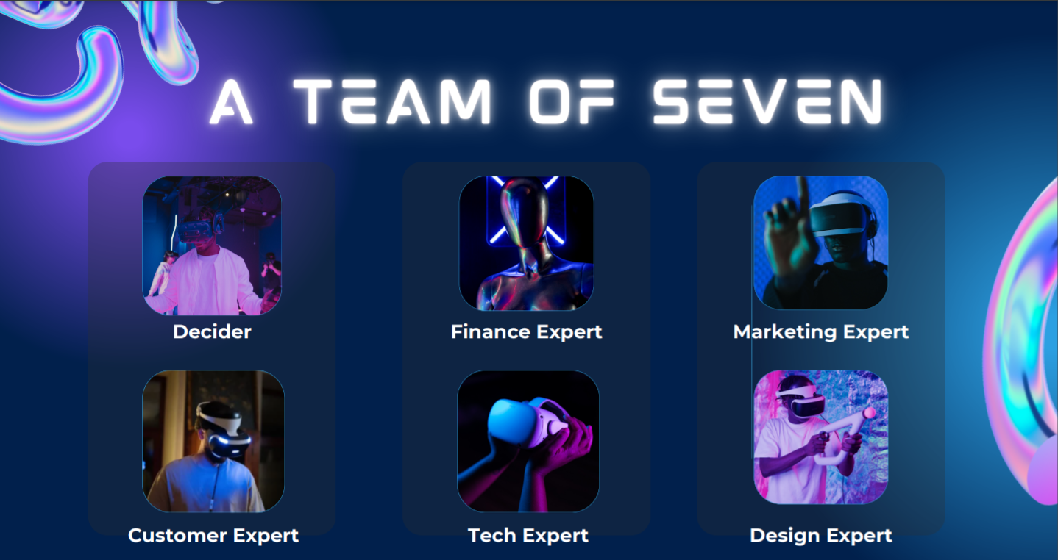

Slide 13
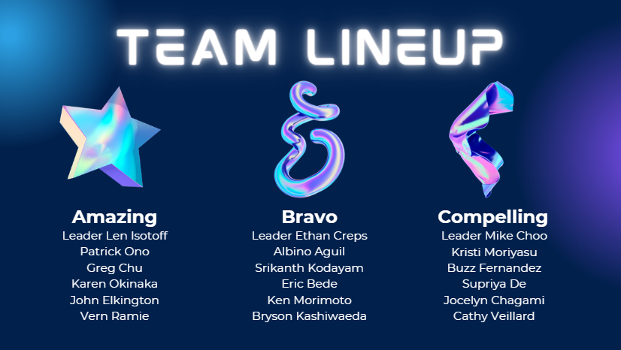
Notes:
Tentative team grouping

Slide 14
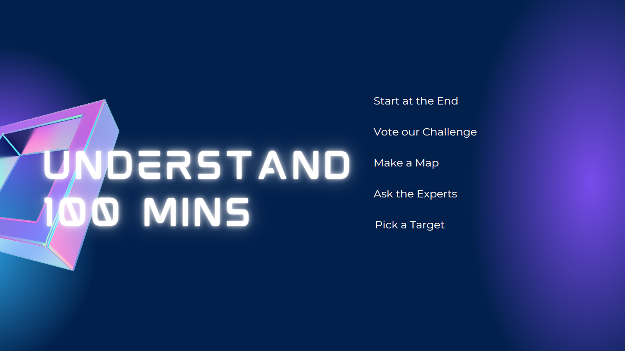

Slide 15
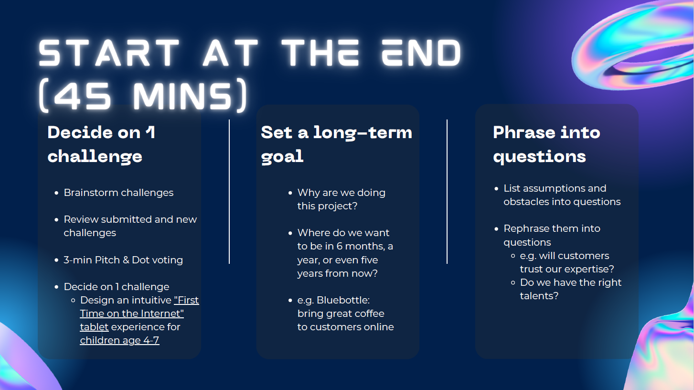

Slide 16
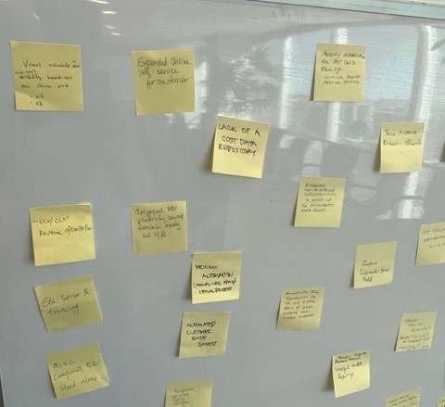
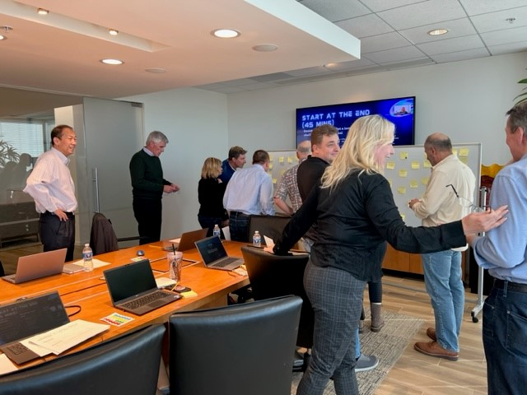
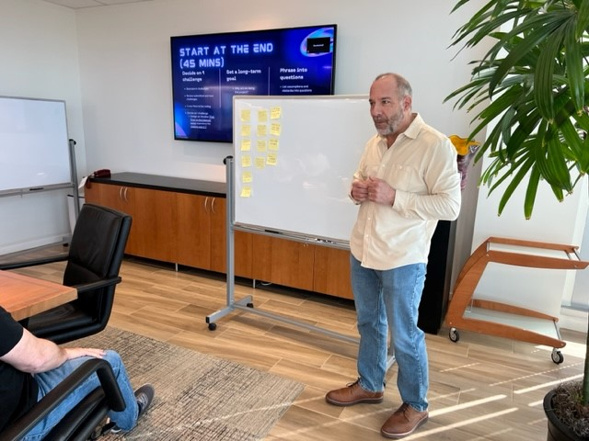

Slide 17
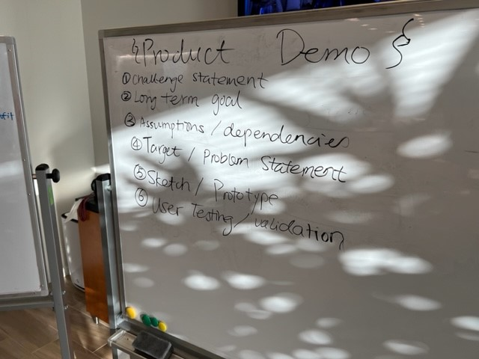

Slide 18
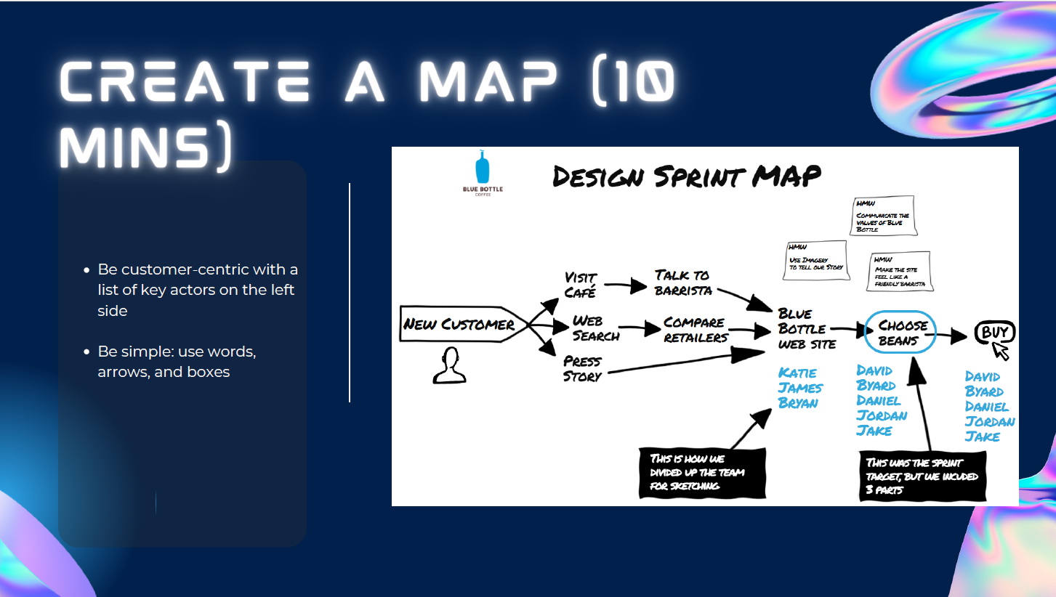

Slide 19
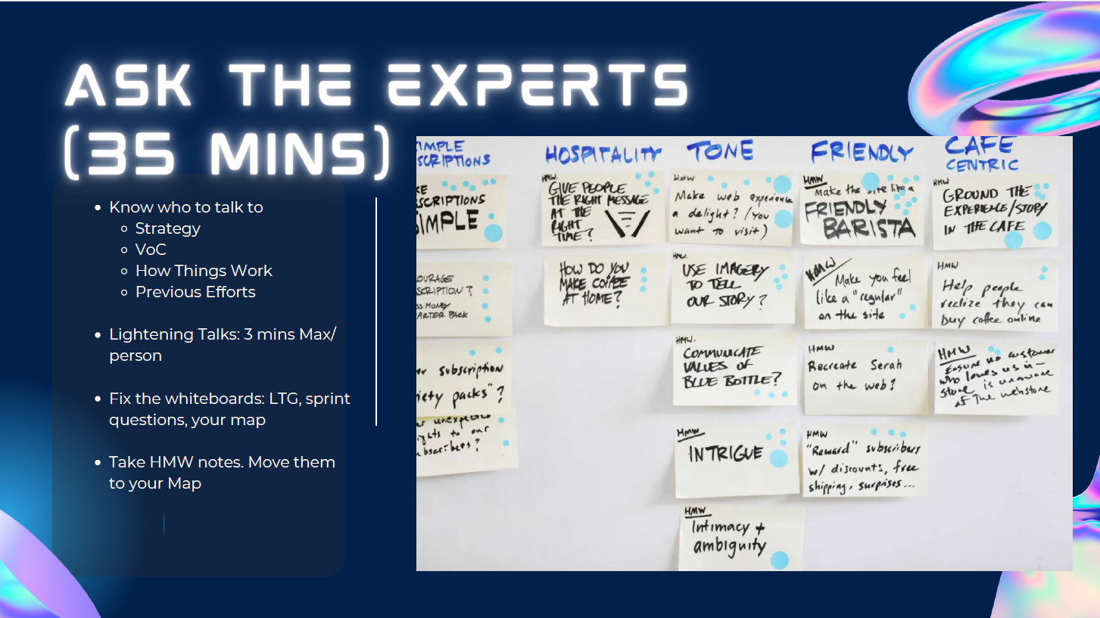

Slide 20
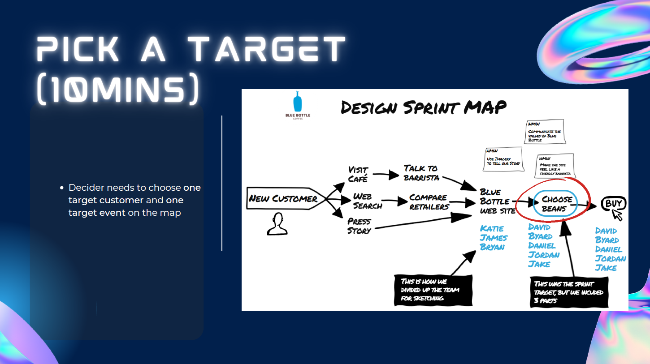

Slide 21
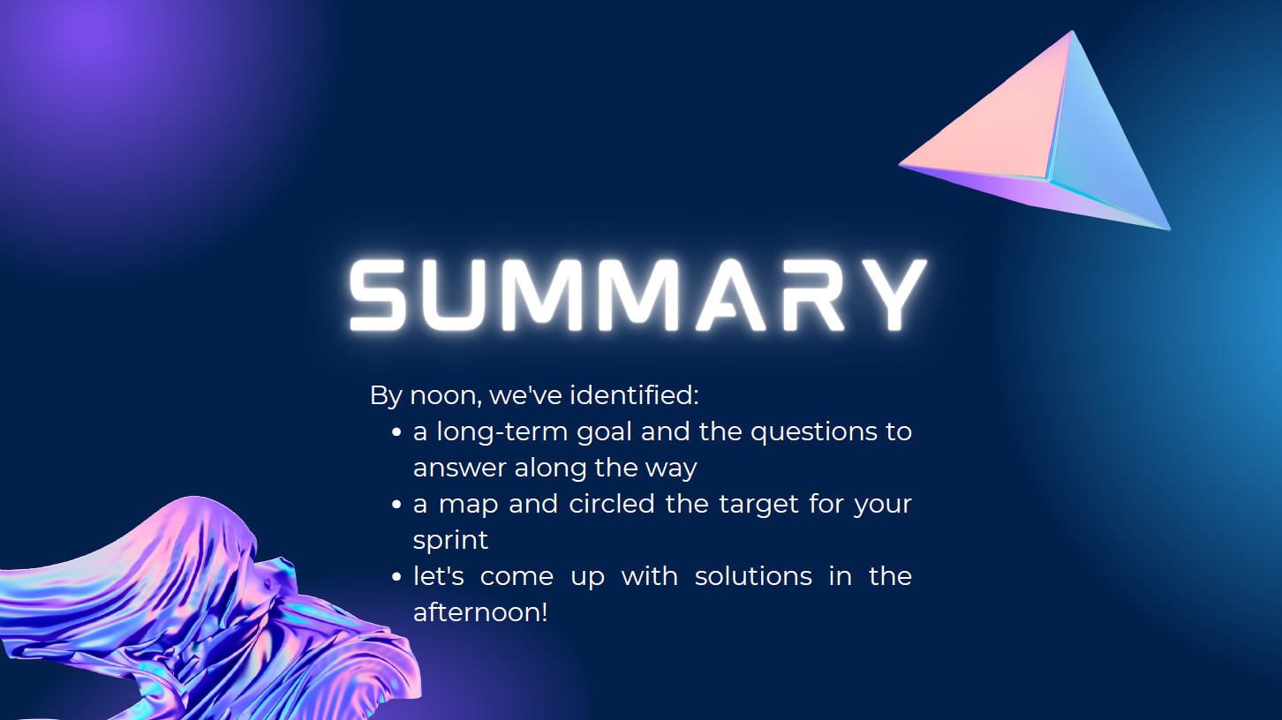

Slide 22


Slide 23
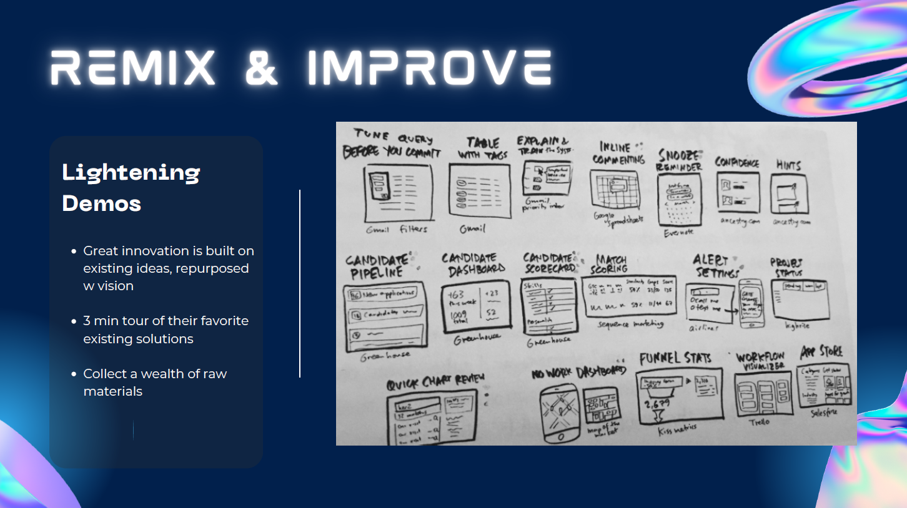

Slide 24


Slide 25


Slide 26
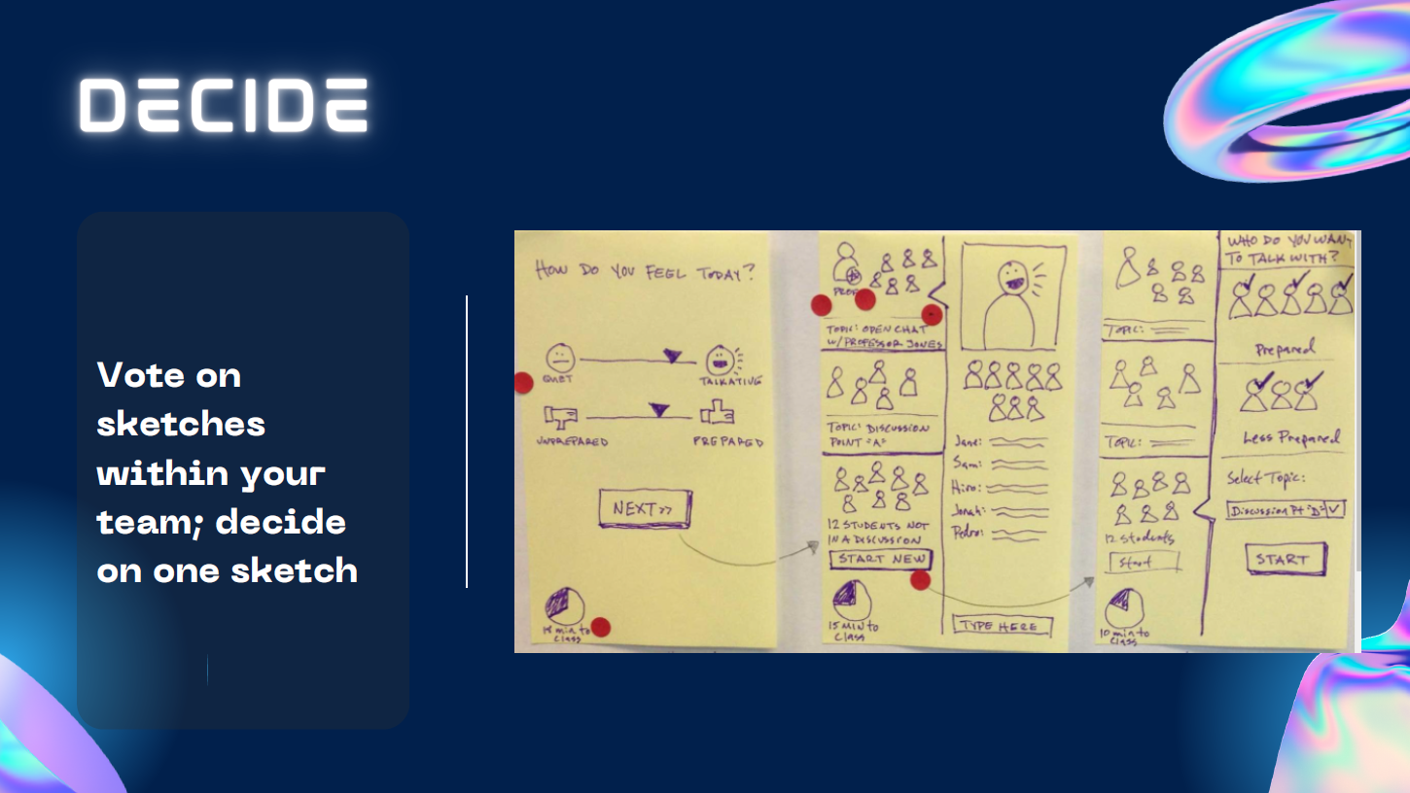

Slide 27
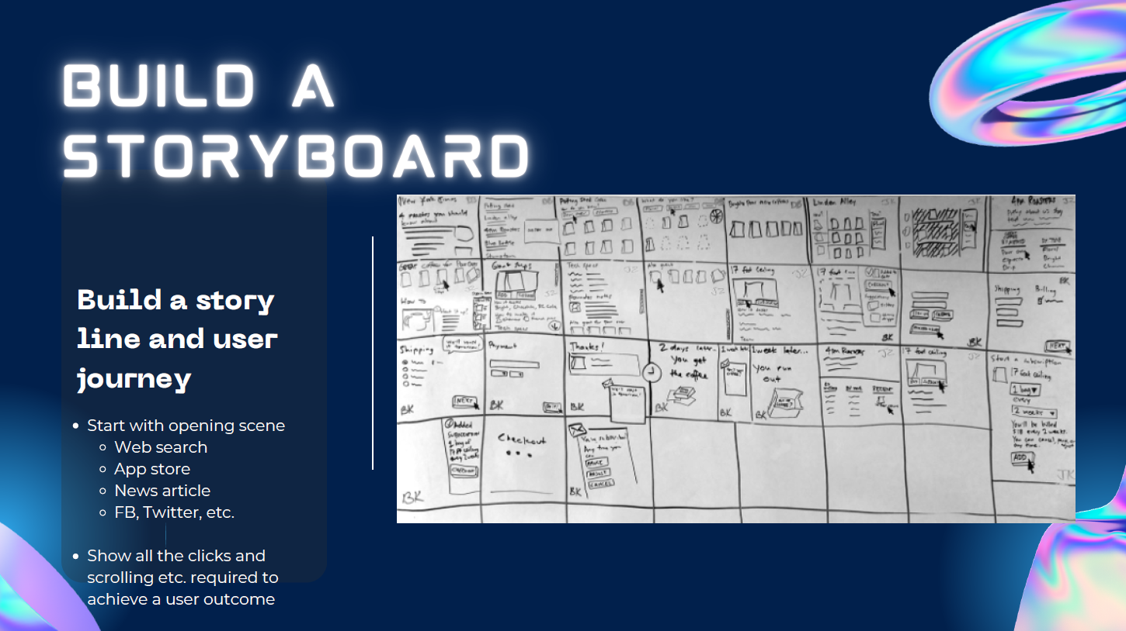

Slide 29
Team Compelling
Matson Innovation
1/17/2023
Qiang Gao
Debarshi Mujherjee
Kyle Hunt
Lee Fishman
Claire Hasl
Jonathan Ogle

Slide 30
Challenge Statement
Design a dynamic cost matrix tool for pricing to help establish timely rate and profit for commercial team to maximize revenue and Margin.

Slide 31
Defining the Problem Statement
For the Pricing, Sales and Customer Service
Who is dissatisfied with the lack of cost data
Our product is a calculator that aggregates all the cost associated with a freight movement
That provides real time viability of cargo movement
Unlike our current method
We have assembled three initial Modules:
Rate Request
Cost Calculator
Admin Module

Slide 32
Step 1: Identify the operating units
Pricing
Sales
Customer Service
Matson Logistics
Equipment Control

Slide 33
Step 2: What are the dynamic costs?
Equipment positioning
Storage
Repair
Cargo handling

Slide 35
Questions?

Slide 36


Slide 37


Slide 38
